Slide 1
Quia Tier 2 Quarter 1 Week 1

Slide 2
Pitch
Definition: How high or low a note sounds

Slide 3
Beat
Definition: The steady pulse in music

Slide 4
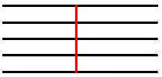
Bar Line
Definition: A vertical line that is used to separate music into measures

Slide 5
Double Bar Line
Definition: Two straight lines used to mark the end of a piece of music

Slide 6
Measure
Definition: area between bar lines that has the notes and rhythms

Slide 7
Music Staff
A music staff has FIVE lines and FOUR spaces
A music staff is what
the notes go on

Slide 8
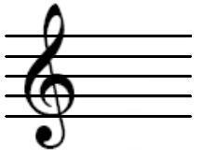
Treble Clef
This is a TREBLE CLEF.
The treble clef indicates notes in a higher range.

Slide 9
Note Durations
Note Name: Whole Note
Note Duration: 4 Counts
Note Name: Half Note
Note Duration: 2 Counts

Slide 10
Note Durations
Note Name: Quarter Note
Note Duration: 1 Count
Note Name: Eighth Note (Flagged)
Note Duration: 1/2 count

Slide 11
Note Durations
Note Name: Eighth Note (Barred)
Note Duration: 1/2 (+) 1/2 = 1
Note Name: Dotted Half Note
Note Duration: 3 Counts

Slide 12
Music Alphabet
A
G
B
F
C
E
D
The Music Alphabet consists of seven notes. Once you get to G you go back to A and repeat again.

Slide 13
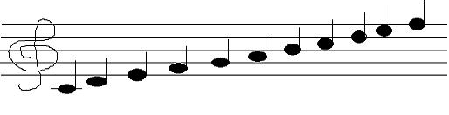
Treble Clef Note Names
E
F
D
B
C
G
A
E
F
D
Middle C

Slide 14
Treble Clef Note Names
What do the letters of the spaces spell?
E
Bottom Space: F
C
2nd Space: A
A
3rd Space: C
F
Top Space: E

Slide 15
Treble Clef Note Names
F
Bottom Line: E
What is a saying we can use to remember the lines?
D
2nd Line: G
B
3rd Line: B
G
4th Line: D
E
Top Line: F

Slide 16
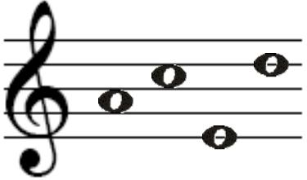
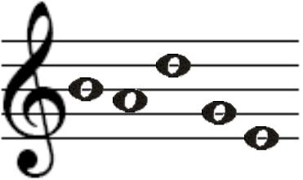
Treble Clef Note Names
ACED
BADGE

Slide 17
Quia Tier 2 Quarter 1 Week 2

Slide 18
Time Signatures
Top Number = How Many Beats per Measure
Top Number = 4 =
4 Beats Per Measure
Top Number = 3 =
3 Beats Per Measure
Top Number = 95 =
95 Beats Per Measure

Slide 19
Time Signatures
Bottom Number = What note gets the beat
__4__
4
__6__
8
__2__
2
Quarter Note
Eighth Note
Half Note

Slide 20
Time Signatures
Common Time –
Another way of writing a 4/4 time signature. It means the SAME as a 4/4 time signature does

Slide 21
Time Signatures
= 4 Beats Per Measure
= Quarter Note gets the Beat
= 3 Beats Per Measure
= Quarter Note gets the Beat

Slide 22
Time Signatures
= 6 Beats Per Measure
= Eighth Note gets the Beat
= 9 Beats Per Measure
= Eighth Note gets the Beat

Slide 23
Rhythm
Definition: The patterns of long and short sounds and silence in music.

Slide 24
Rhythm Examples
A plus sign (+) will be used for the second half of the beat
1 2 + 3 + 4

Slide 25
Rhythm Examples
An underscore (_) will be used when notes receive more than one count
1 + 2_3 4 +

Slide 26
Rhythm Examples
A space will go between counts for new notes
1_2_3 4 1_2_3_4
1_2_3 4 1_2 3_4

Slide 27
Rhythm Fill in the Blank
What notes will complete the following measures? Write in the note name
Quarter Note
Half Note

Slide 28
Rests
Definition: A rest is a time in the music when no singing or playing occurs

Slide 29
Rest Types
Rest Name: Whole Rest
Rest Duration: 4 counts
Rest Name: Half Rest
Rest Duration: 2 counts

Slide 30
Rest Types
Rest Name: Quarter Rest
Rest Duration: 1 count
Rest Name: Eighth Rest
Rest Duration: 1/2 count

Slide 31
Solfege
Definition: A series of syllables that correspond to the notes of the scale

Slide 32
Solfege
DO
TI
LA
SOL
FA
MI
RE
DO

Slide 33
Solfege
If C is “DO”…
DO - C | RE – | MI – | FA –
SOL – | LA – | TI – | DO-

Slide 34
Solfege
If C is “DO”…
DO - C | RE – D | MI – E | FA – F
SOL – G | LA – A | TI – B | DO- C

Slide 35
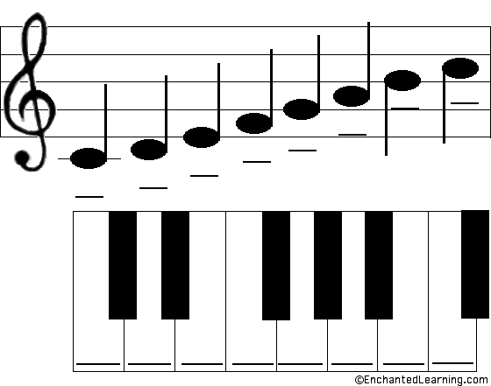
Solfege
TI
DO
LA
FA
SOL
RE
MI
DO

Slide 36
Solfege
DO RE MI MI FA SOL SOL FA MI RE DO MI DO

Slide 37
Solfege
DO RE MI MI MI SOL SOL FA MI RE DO SOL DO

Slide 38
Solfege
If F is “DO”…
DO - F | RE - | MI - | FA -
SOL - | LA - | TI - | DO-

Slide 39
Solfege
If F is “DO”…
DO - F | RE – G | MI – A | FA - B
SOL – C | LA - D | TI – E | DO- F

Slide 40
Solfege
DO DO RE MI MI FA SOL MI MI DO

Slide 41
Solfege
If G is “DO”…
DO - G | RE - | MI - | FA -
SOL - | LA - | TI - | DO-

Slide 42
Solfege
If G is “DO”…
DO - G | RE – A | MI – B | FA – C
SOL – D | LA – E | TI – F | DO- G

Slide 43
Solfege
DO MI SOL SOL MI DO RE RE MI RE DO

Slide 44
Quia Tier 2 Quarter 1 Week 3

Slide 45
Major Scale
Definition: A series of notes based on musical steps

Slide 46
Solfege for a Major Scale
DO
TI LA SOL FA MI RE DO

Slide 47
Solfege
If E is “DO”…
DO – E | RE – | MI – | FA –
SOL – | LA – | TI – | DO-

Slide 48
Solfege
If E is “DO”…
DO – E | RE – F | MI – G | FA – A
SOL – B | LA – C | TI – D | DO- E

Slide 49
Solfege
MI RE DO MI RE DO DO MI SOL LA SOL FA MI RE DO

Slide 50
Solfege
If D is “DO”…
DO – D | RE – | MI – | FA –
SOL – | LA – | TI – | DO-

Slide 51
Solfege
If E is “DO”…
DO – D | RE – E | MI – F | FA – G
SOL – A | LA – B | TI – C | DO- D

Slide 52
Solfege
MI RE DO DO DO MI SOL FA MI RE RE MI RE DO

Slide 53
Rhythm and Rests
Remember to check your time signatures!
Parentheses go around rest counts to indicate silence
1 + 2 (3) + 4 (1) 2_3_4
1_2_3 4 + (1_2_3_4)

Slide 54
Rhythm and Rests
1 + (2_3) 4 + 1_2_3 (4) +

Slide 55
Rhythm Fill in the Blank
What rest would complete the following measures?
Quarter Rest
Half Rest

Slide 56
Quia Tier 2 Quarter 1 Week 4

Slide 57
Dynamics
Definition: How loud or soft you sing

Slide 58
Dynamics
English Word
Italian Word
Very Loud/Strong
Loud/Strong
Medium Loud/Strong
Medium Soft
Soft
Very Soft
Gradually get louder
Gradually get softer
Fortissimo
Forte
Mezzo Forte
Mezzo Piano
Piano
Pianissimo
Crescendo
Decrescendo

Slide 59
Dynamics
English Word
Symbol
Very Loud/Strong
Loud/Strong
Medium Loud/Strong
Medium Soft
Soft
Very Soft
Gradually get louder
Gradually get softer
ff
f
mf
mp
p
pp
<
>

Slide 60
Quia Tier 2 Quarter 1 Week 5

Slide 61
Unison
Definition: When everyone is singing the same thing at the same time

Slide 62
Harmony
Definition: When different voice parts are singing different rhythms or notes at the same time

Slide 63
Quia Tier 2 Quarter 1 Week 6

Slide 64
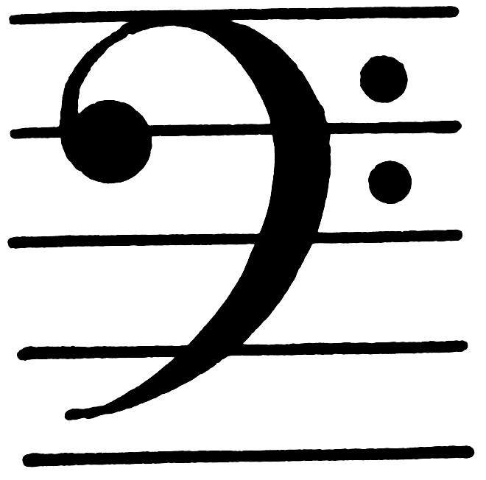
Bass Clef
This is a BASS CLEF.
The bass clef is used to indicate notes in a lower range.
**Practice drawing bass clefs**

Slide 65
Bass Clef Note Names
B
C
G
A
E
F
C
D
B
A
G

Slide 66
Bass Clef Note Names
What is a saying we can use to remember the spaces?
G
Bottom Space: A
E
2nd Space: C
C
3rd Space: E
A
Top Space: G

Slide 67
Bass Clef Note Names
A
Bottom Line: G
What is a saying we can use to remember the lines?
F
2nd Line: B
D
3rd Line: D
B
4th Line: F
G
Top Line: A

Slide 68
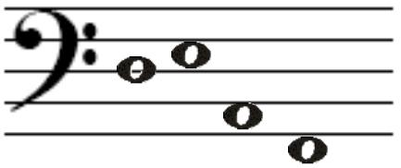
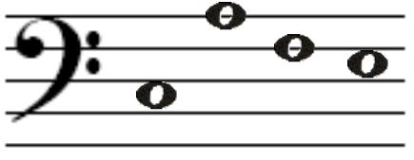
Bass Clef Note Names
DEAF
CAFE

