Slide 1
Quia Tier 2 Quarter 2 Week 1

Slide 2
Sixteenth Notes
Note Name: SIXTEENTH NOTE
Note Duration:
¼ Count

Slide 3
Counting Sixteenth Notes
4 sixteenth notes = 1 beat
1 e + a
=

Slide 4
Rhythm Counting
1 e + a 2 e + a (3_4) 1 e + a 2 + 3 e + a (4)
1_2 3 e + a 1 + 2 e + a (3) +

Slide 5
Rhythm Counting
(1_2_3_4) 1 e + a 2 e + a 3 4 (+)

Slide 6
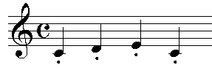
Staccato
An Italian term that indicates notes should be short and separated
Draw a staccato note next to the definition of staccato

Slide 7
Legato
An Italian term that indicates notes should be played smooth and connected

Slide 8
Quia Tier 2 Quarter 2 Week 2

Slide 9
Key Signature
Definition: A key signature tells us what notes are flatted or sharped in the song

Slide 10
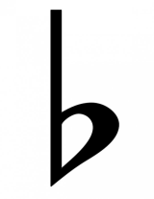
Flats
NAME: Flat Symbol
What does a flat do to a note?
A flat symbol lowers a note a half step

Slide 11
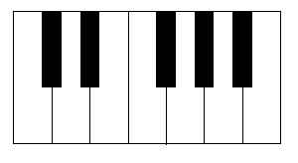
Flats
Gb
G
Move down a HALF STEP from G

Slide 12
Order of the Flats
There is a certain order that flats get used in…
WHAT’S THE ORDER OF THE FLATS?
BEADGCF

Slide 13
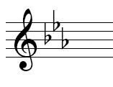
Flat Identification
What flats are being used?
Bb
Eb
Ab
F
E
D
C
B
A
G
F
E

Slide 14
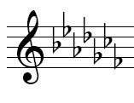
Flat Identification
What flats are being used?
Bb
Eb
Ab
Db
Gb
Cb
Fb

Slide 15
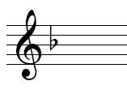
Flat Identification
What flats are being used?
Bb

Slide 16
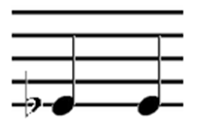
Flat Accidentals
True or False: The first note is higher than the second note.
FALSE
Eb
E

Slide 17
Flat Accidentals
True or False: The first note is higher than the second note.
TRUE
E
Db

Slide 18
Flat Accidentals
True or False: The first note is higher than the second note.
FALSE
G
Ab

Slide 19
Flat Accidentals
True or False: The first note is higher than the second note.
FALSE
Bb
B

Slide 20
Finding “DO”
NO FLATS OR SHARPS
DO = C

Slide 21
Finding “DO”
NO FLATS OR SHARPS
Key signature is CLEAR

Slide 22
Finding “DO”
ONE FLAT
Do = F

Slide 23
Finding “DO”
ONE FLAT
First
Flat

Slide 24
Rule for Finding “DO”
The second to last flat is the key signature

Slide 25
Rule for Finding “DO”
Find second to last flat
Determine name of the flat
Name of flat = DO
DO = D-FLAT

Slide 26
Finding “DO”
TWO FLATS
Do = B-flat

Slide 27
Finding “DO”
THREE FLATS
Do = E-flat

Slide 28
Finding “DO”
FOUR FLATS
Do = A-flat

Slide 29
Finding “DO”
FIVE FLATS
Do = D-flat

Slide 30
Finding “DO”
SIX FLATS
Do = G-flat

Slide 31
Finding “DO”
SEVEN FLATS
Do = C-flat

Slide 32
Quia Tier 2 Quarter 2 Week 3

Slide 33
Flat Solfege
WHAT IS DO?
E-Flat
DO TI DO RE MI

Slide 34
Flat Solfege
WHAT IS DO?
F
MI RE DO TI DO

Slide 35
Flat Solfege
WHAT IS DO?
D-Flat
DO TI LA TI DO

Slide 36
Flat Solfege
WHAT IS DO?
C-Flat
DO MI SOL MI DO

Slide 37
Triad
Definition: A chord of three notes, each a third apart

Slide 38
Solfege Used for a Triad
SOL
MI
DO

Slide 39
Quia Tier 2 Quarter 2 Week 4

Slide 40
Sharps
NAME: Sharp Symbol
What does a sharp do to a note?
A sharp symbol raises a note a half step

Slide 41
Sharps
G#
G
Move up a HALF STEP from G

Slide 42
Order of the Sharps
There is a certain order that sharps get used in…
FCGDAEB

Slide 43
Order of the Sharps
Fried Chicken Goes Down Awfully Easy Baby

Slide 44
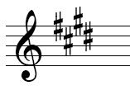
Sharp Identification
What sharps are being used?
F# C# G# D#

Slide 45
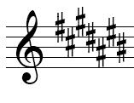
Sharp Identification
What sharps are being used?
F# C# G# D# A#
E# B#

Slide 46
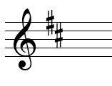
Sharp Identification
What sharps are being used?
F# C#

Slide 47
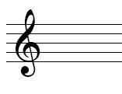
Finding DO
No Flats or Sharps
Key Signature is Clear
SO
DO= C

Slide 48
Rule for finding DO
Take the last sharp and go up to the next note. This note is DO.

Slide 49
Rule for finding DO
Identify the last sharp
D#
2. What is the note name?
D#
Move up to the next line/space.
What is the note name?
E=DO

Slide 50
Rule for finding DO
Is there a sharp on E?
NO
Is there a sharp in the key signature name?
NO

Slide 51
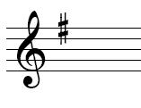
Finding DO
ONE SHARP
Do = G

Slide 52
Finding DO
TWO SHARPS
Do = C

Slide 53
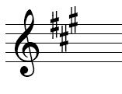
Finding DO
THREE SHARPS
Do = A

Slide 54
Finding DO
FOUR SHARPS
Do = E

Slide 55
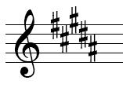
Finding DO
FIVE SHARPS
Do = B

Slide 56
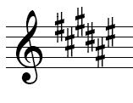
Finding DO
SIX SHARPS
Do = F#
Why F# and not F?

Slide 57
Finding DO
SEVEN SHARPS
Do =C#
Why C# and not C?

Slide 58
Quia Tier 2 Quarter 2 Week 5

Slide 59
Sharp Solfege
WHAT IS DO?
D
DO MI SOL LA FA

Slide 60
Sharp Solfege
WHAT IS DO?
E
DO MI LA TI SOL

Slide 61
Sharp Solfege
WHAT IS DO?
C#
DO LA MI TI SOL

