Slide 1
Quia Tier 2 Unit 4 Week 1

Slide 2
6/8 Time Signature
6 Beats per measure
Eighth note gets the beat

Slide 3
Note Values in 6/8
=
1 COUNT
=
2 COUNTS

Slide 4
Note Values in 6/8
=
3 COUNTS
=
6 COUNTS

Slide 5
6/8 Time Signature
Write in the counts for the following examples:
1 2 3 4 5 6 1_2_3_4_5_6

Slide 6
6/8 Time Signature
1 2_3 4_5 6 1_2_3_4_5_6

Slide 7
6/8 Time Signature
1_2_3_4_5_6 1 2_3 4_5_6

Slide 8
6/8 Time Signature
1_2 3 4 5_6 1 2 3 4_5_6

Slide 9
Quia Tier 2 Quarter 4 Week 2

Slide 10
Natural
Name: Natural Symbol
What does a natural do to a note?
A natural symbol cancels out a flat or sharp

Slide 11
Quia Tier 2 Quarter 4 Week 3

Slide 12
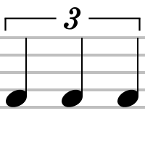
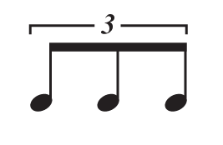
Triplets
=
QUARTER note triplet
=
EIGHTH note triplet

Slide 13
Quarter Note Triplets
=
QUARTER note triplet
=
TWO Counts

Slide 14
Quarter Note Triplets
1lali
=
*Practice counting as group*

Slide 15
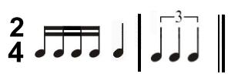
Quarter Note Triplets
1_2_3_+_4 + 1lali 3lali
1 e + a 2 1lali

Slide 16
Quarter Note Triplets
1_2_3 4lali 5_1 2lali 4_5

Slide 17
Quia Tier 2 Quarter 4 Week 4

Slide 18
REVIEW

Slide 19
Quia Tier 2 Quarter 4 Week 5

Slide 20
REVIEW

Slide 21
Quia Tier 2 Quarter 4 Week 6

Slide 22
Rest Values in 6/8
= 1 count
= 3 counts
= 2 counts
= 6 counts

Slide 23
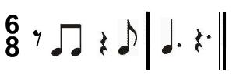
Rhythm Counting
(1) 2 3 (4_5) 6 1_2_3 (4_5_6)
1_2_3 (4_5_6) (1_2_3_4_5_6)

Slide 24
Rhythm Counting
1 2 3 (4_5) 6 (1_2_3) 4 5_6

