Slide 1
Quia Tier 3 Unit 4 Week 1

Slide 2
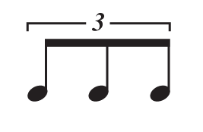
Triplets
Note Name: Eighth Note Triplet
Note Value: 1 Count

Slide 3
Counting for Triplets
1LaLi
=

Slide 4
Counting for Triplets
1lali 2 3lali 4 1lali 2_3_4
1_+_2 + 1lali 2lali

Slide 5
Counting for Triplets
1 2lali (3) (1) + 2 3lali

Slide 6
Quia Tier 3 Unit 4 Week 2

Slide 7
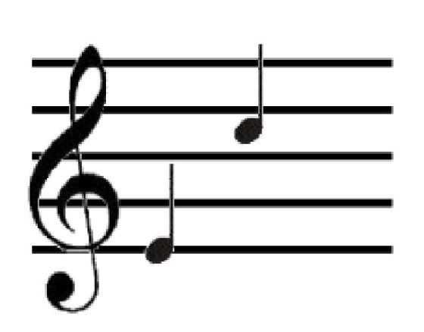
Interval
SIXTH

Slide 8
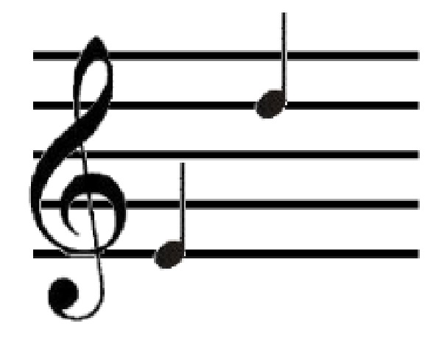
Intervals
Name of Interval:
SEVENTH

Slide 9
Intervals and Solfege
What solfege syllable is a sixth above DO? LA
What solfege syllable is a seventh above DO? TI
What letter name is a sixth above C? A
What letter name is a seventh above C? B

Slide 10
Natural
Name: Natural Symbol
What does a natural do to a note?
A natural symbol cancels out a flat or sharp

Slide 11
Natural Accidentals
IF B-FLAT WAS “DO” THEN B-NATURAL WOULD BE
WHY?
IF E-FLAT WAS “SOL”, THEN E-NATURAL WOULD BE
WHY?
IF C-SHARP WAS “MI”, THEN C-NATURAL WOULD BE
WHY?
DI
SI
ME

Slide 12
Natural Accidentals
Do Re Mi Re Di Ti Do

Slide 13
Natural Accidentals
Do Re Ti Do Mi Me Mi Do La

Slide 14
Natural Accidentals
Mi Fa Si Fa Mi Ri Do

Slide 15
Quia Tier 3 Quarter 4 Week 3

Slide 16
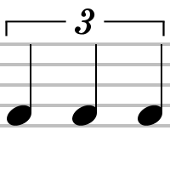
Triplets
=
QUARTER note triplet
=
EIGHTH note triplet

Slide 17
Quarter Note Triplets
=
QUARTER note triplet
=
TWO Counts

Slide 18
Quarter Note Triplets
1lali
=
*Practice counting as group*

Slide 19
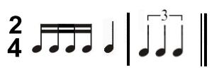
Quarter Note Triplets
1_2_3_+_4 + 1lali 3lali
1 e + a 2 1lali

Slide 20
Quarter Note Triplets
1_2_3 4lali 5_1 2lali 4_5

Slide 21
Quia Tier 3 Quarter 4 Week 4

Slide 22
Counting Rhythms
We already know that…
= 1 e + a

Slide 23
But what happens when we combine sixteenth notes and eighth notes?

Slide 24
Counting Rhythms
Different rhythms are made!

Slide 25
= 1 e +

Slide 26
= 1 + a

Slide 27
= 1 e a

Slide 28
1 la li 3 + 1 e a 2 + a 3 e +
1_2_3 (+) 4 e + 1 + a 2_3_4

Slide 29
1 e + 2 la li 1 e a + 2 + 3 e a

Slide 30
Quia Tier 3 Quarter 4 Week 5

Slide 31
Mixed Accidental Solfege
Mi La Do Te La Sol Me
La La Ti La La Si Do Mi Sol

Slide 32
Mixed Accidental Solfege
La Do Mi Do Ti Si La

Slide 33
Quia Tier 3 Quarter 4 Week 6

Slide 34
Quia Tier 3 Quarter 4 Week 7

