Slide 1
Quia Tier 4 Unit 4 Week 1

Slide 2
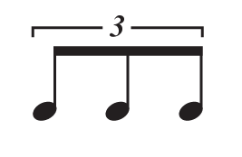
Triplets
Note Name: Eighth Note Triplet
Note Value: 1 Count

Slide 3
Counting for Triplets
1LaLi
=
*Practice counting as group*

Slide 4
Counting for Triplets
1lali 2 3lali 4 1lali 2_3_4
1 2lali (3) (1) + 2 3lali

Slide 5
Counting for Triplets
1_+_2 + 1lali 2lali

Slide 6
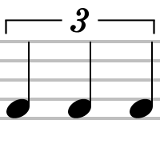
Triplets
=
QUARTER note triplet
=
EIGHTH note triplet

Slide 7
Quarter Note Triplets
=
QUARTER note triplet
=
TWO Counts

Slide 8
Quarter Note Triplets
1 la li
=
*Practice counting as group*

Slide 9
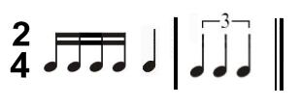
Quarter Note Triplets
1_2_3_+_4 + 1 la li 3 la li
1 e + a 2 1 la li

Slide 10
Quarter Note Triplets
1_2_3 4lali 5_1 2 la li 4_5

Slide 11
Fermata
Name: Fermata
What Does Fermata Do?
Sing or play the note for as long as the director holds it

Slide 12
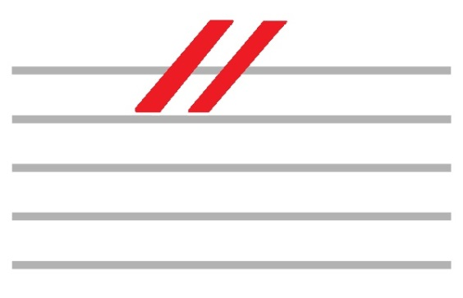
Caesura
Name: Caesura
What Does Caesura Do?
A caesura tells you to hold a note for as long as the director conducts

Slide 13
Quia Tier 4 Unit 4 Week 2

Slide 14
Natural
Name: Natural Symbol
What does a natural do to a note?
A natural symbol cancels out a flat or sharp

Slide 15
Natural Accidentals
IF B-FLAT WAS “DO” THEN B-NATURAL WOULD BE
WHY?
IF E-FLAT WAS “SOL”, THEN E-NATURAL WOULD BE
WHY?
IF C-SHARP WAS “MI”, THEN C-NATURAL WOULD BE
WHY?
DI
SI
ME

Slide 16
Natural Accidentals
Do Re Mi Re Di Ti Do

Slide 17
Natural Accidentals
Do Re Ti Do Mi Me Mi Do La

Slide 18
Natural Accidentals
Mi Fa Si Fa Mi Ri Do

Slide 19
Quia Tier 4 Unit 4 Week 3

Slide 20
Pick-up
Definition:
The note or set of notes that occur in the measure before the phrase actually starts.

Slide 21
Pick Up Counting
4 + 1_2 3_+_4 + (1_2_3_4) (1) 2_+_3 + 4
3_4 1 2 +_3_+ (4) (1_2) 3_+_4 +

Slide 22
Pick Up Counting
3 +_4_+ 1_+_2 + 3_+_4 + (1) + 2_3_4
4 1e+a 2_+_3 + (4) 1e+a 2 +_3_+ (4)

Slide 23
Quia Tier 4 Unit 4 Week 4

Slide 24
Counting Rhythms
We already know that…
= 1 e + a

Slide 25
Counting Rhythms
= 1 e +

Slide 26
Counting Rhythms
= 1 + a

Slide 27
Counting Rhythms
= 1 e a

Slide 28
Counting Rhythms
1 la li 3 + 1 e a 2 + a 3 e +
1_2_3 (+) 4 e + 1 + a 2_3_4

Slide 29
Counting Rhythms
1 e + 2 la li 1 e a + 2 + 3 e a

Slide 30
Quia Tier 4 Unit 4 Week 5

Slide 31
Mixed Accidental Solfege
La Do Mi Do Ti Si La

Slide 32
Mixed Accidental Solfege

Slide 33
Mixed Accidental Solfege
Mi Fa Si Fa Mi Ri Do

Slide 34
Mixed Accidental Solfege

Slide 35
Quia Tier 4 Unit 4 Week 6

Slide 36
SATB
SOME MUSIC IS WRITTEN IN SATB FORMAT…
THE “S” IN SATB STANDS FOR SOPRANO
THE “A” IN SATB STANDS FOR ALTO
THE “T” IN SATB STANDS FOR TENOR
THE “B” IN SATB STANDS FOR BASS

Slide 37
SAB
SOME MUSIC IS WRITTEN IN SAB FORMAT…
THE “S” IN SATB STANDS FOR SOPRANO
THE “A” IN SATB STANDS FOR ALTO
THE “B” IN SATB STANDS FOR BARITONE

Slide 38
SATB/SAB
The SOPRANO is the higher female voice
The ALTO is the lower female voice
The TENOR is the higher male voice
The BARITONE is the middle male voice
The BASS is the lower male voice

Slide 39
SATB/SAB
In three and four part music, this clef is typically used for SOPRANO and ALTO.

Slide 40
SATB/SAB
In four part music, this clef is typically used for TENORS.

Slide 41
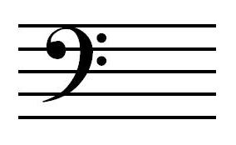
SATB/SAB
In three part music, this clef is typically used for BARITONE.
In four part music, this clef is typically used for BASS.

Slide 42
Quia Tier 4 Unit 4 Week 7

